Slide 1
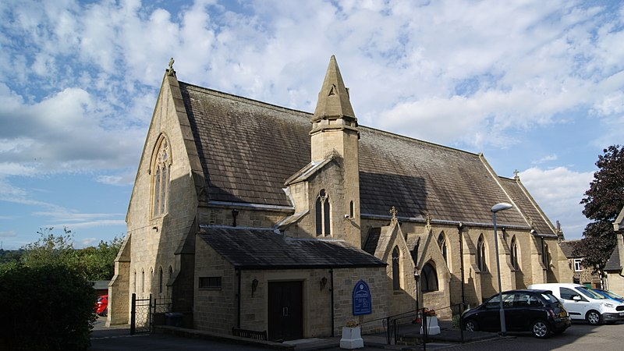
Our Lady and All Saints Church

Slide 2
Parish priest
Our parish priest is called Father Lawrie and he is a very kind person. He Baptised me and my brothers. Father Lawrie says all the parish masses and is a very busy person!

Slide 3
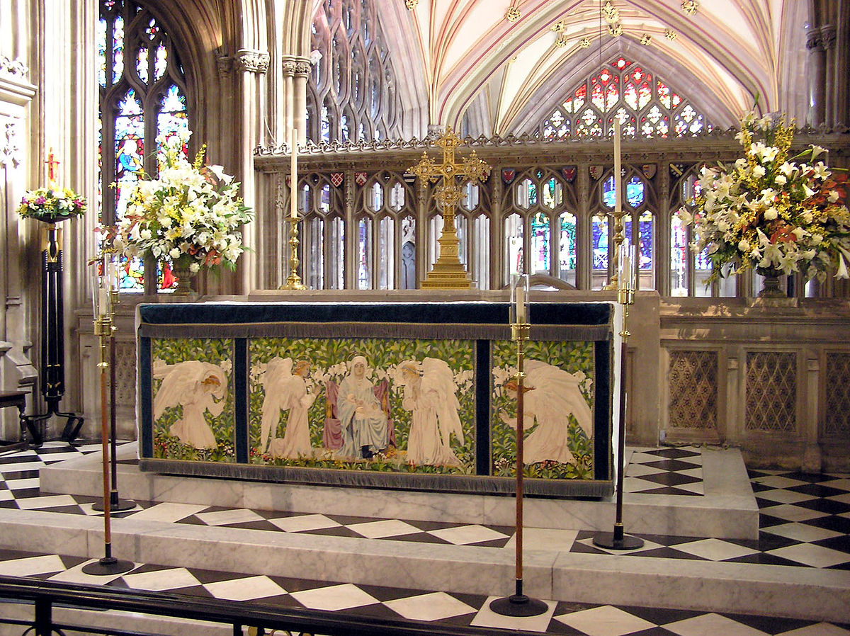
Special objects in our church.
The Altar
We have a special altar and it makes us remember the last supper where Jesus broke bread and drank wine with his disciples before he gave his life for his people.

Slide 4
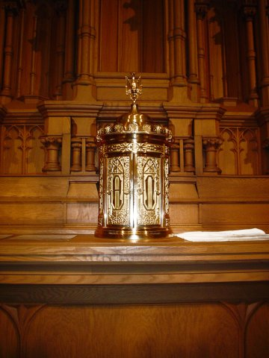
Tabernacle
The tabernacle is a holy place we the priest keeps the bread and wine. We also call that the blessed sacrament.

Slide 5
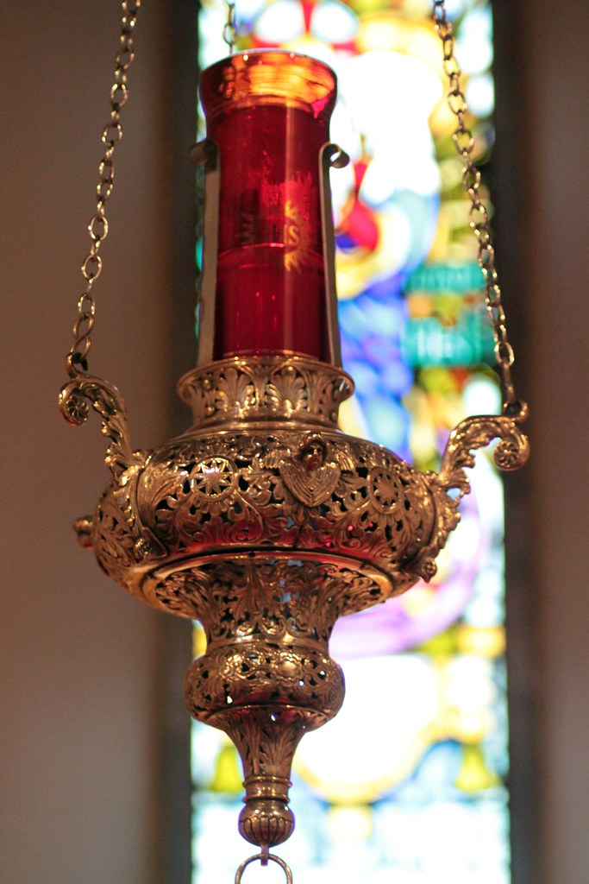
Sanctuary Light
The sanctuary light shows us that Jesus is the light of the world and it is a reminder that the bread and wine is in the tabernacle.

Slide 6
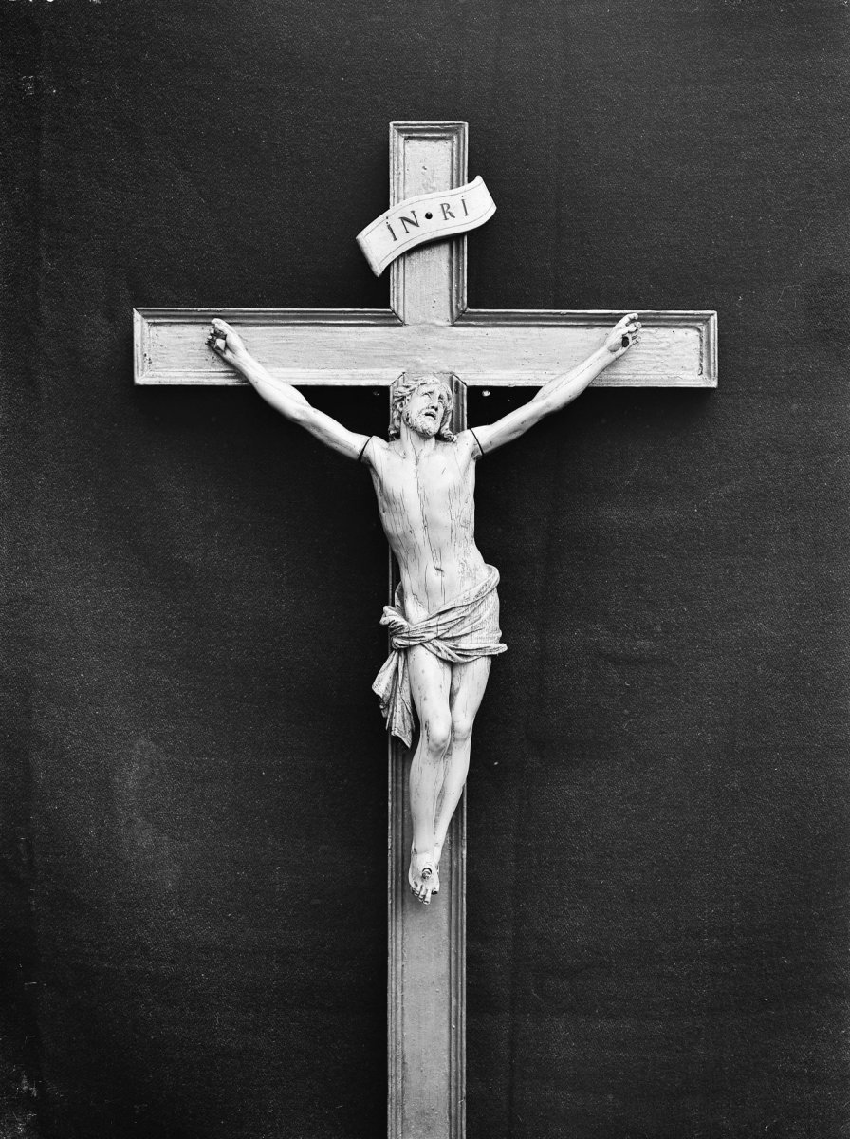
Crucifix
We know that Jesus died on the cross for us so we could live happily and in peace. The crucifix reminds us of this in church and that Jesus will always love us.

Slide 7
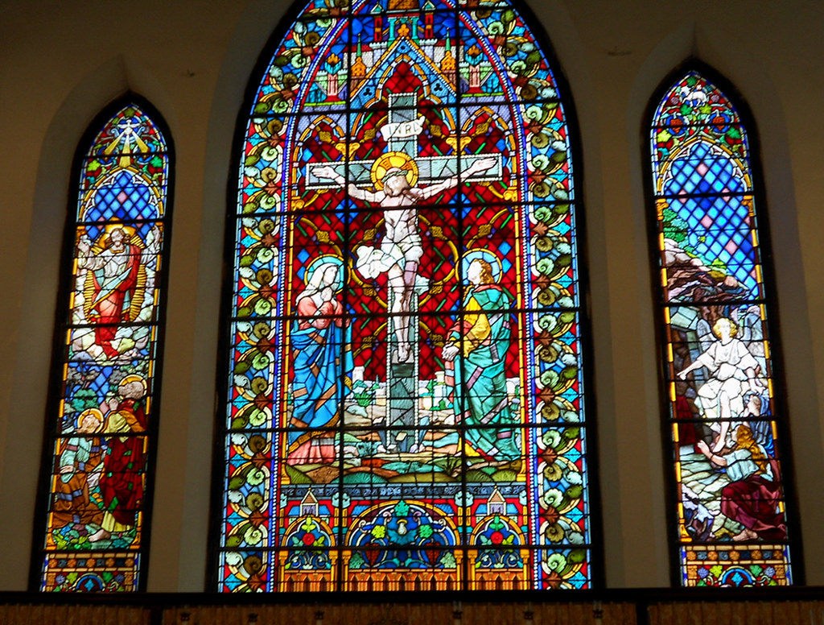
Stained Glass Window
The stained glass windows in church tell a story like a picture book. They are bright and colourful.

Slide 8
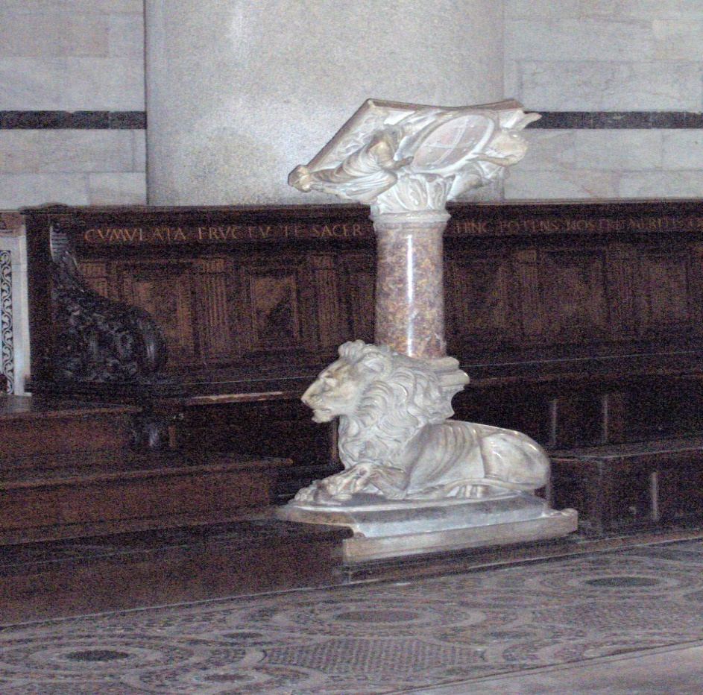
Lecturn
The special holy book which we call the Bible rests on the lecturn. The lecturn is like a tall stand made from wood or stone.

Slide 9
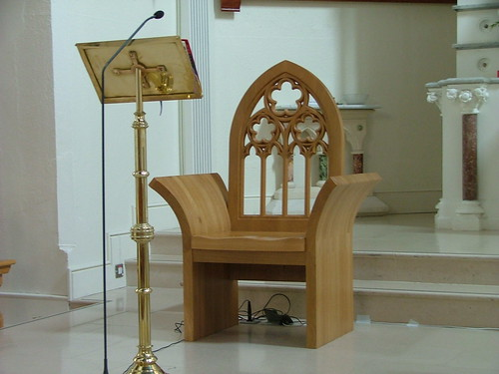
Priest’s Chair
In church the priest has a very special chair where he sits and prays. The priest reminds us of Jesus in church so he has an important seat where we can all see him.

Slide 10
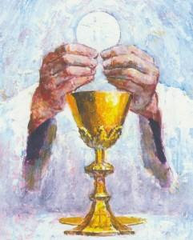
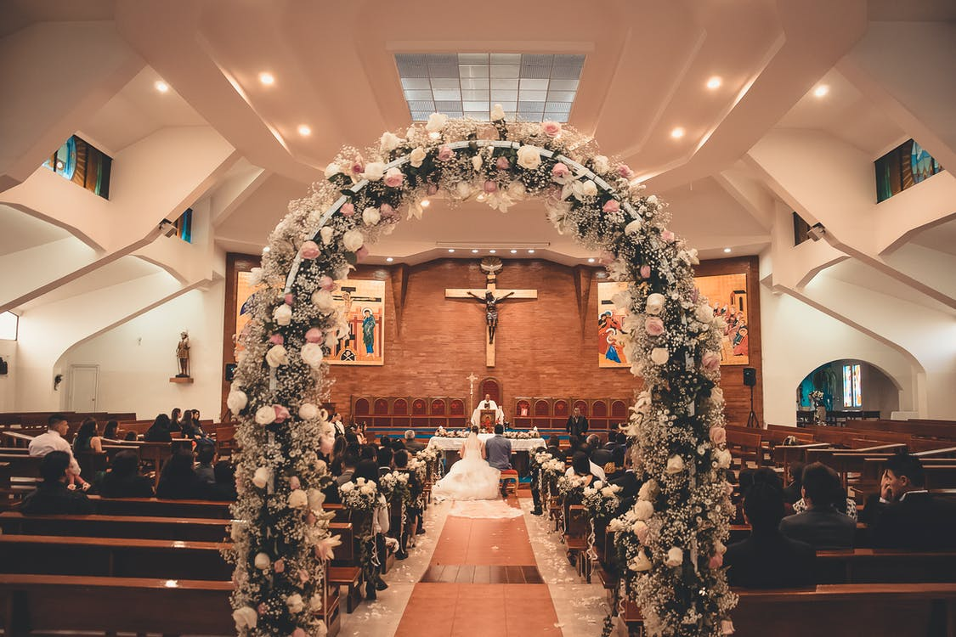
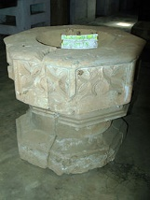
Important events in church
Wedding- this is a gift from God and a commitment in front of the church.
Baptism- we get baptised to become part of God’s family. This is celebrated in front of our family and friends.
Holy Communion- when we make our first Holy Communion we are allowed to take the bread of Jesus for the first time.

